Slide 1


Chapter 6: Kubernetes Logging, Monitoring and Health checks
Agile Brains Consulting
1
©Agile Brains Consulting Inc. All rights reserved. Not to be reproduced without prior written consent.

Slide 2
Table of Content
Monitoring
Metrics to monitor
Monitoring tools
Lab on K8s dashboard
Lab on cAdvisor+Prometheus
Lab on cAdvisor+Prometheus+Grafana
Logging
Cluster level logging
Lab on EFK setup for logging
Helm Charts
Custom Healthchecks
Liveness probes
Readiness probes

Slide 3
Kubernetes Monitoring
Agile Brains Consulting
3
©Agile Brains Consulting Inc. All rights reserved. Not to be reproduced without prior written consent.

Slide 4
Metrics to Monitor
Cluster Monitoring
Node resources – network bandwidth, disk/CPU/memory utilization
Number of nodes – health of nodes & price justification
Running pods – how many nodes may fail before the remaining nodes can run all desired resources
Pod Monitoring
K8s metrics – pod handling by orchestrator, # of replica, rolling update, in-progress deployments
Container metric – CPU, network, memory of each container
Application metric – depends on business rules
Agile Brains Consulting
4
©Agile Brains Consulting Inc. All rights reserved. Not to be reproduced without prior written consent.

Slide 5
Monitoring
Components required
collect logs -> store data -> aggregation -> view results
Why it is hard in Kubernetes?
Containers are disposable
Several layers of abstraction between the application and the underlying hardware to ensure portability and scalability
Lots of moving parts - multiple services, namespaces, roles, nodes, etc. are spread across the infrastructure
So many moving parts contributes to a significant blind spot when it comes to conventional monitoring
Agile Brains Consulting
5
©Agile Brains Consulting Inc. All rights reserved. Not to be reproduced without prior written consent.

Slide 6
Default Monitoring Options
Kubernetes Dashboard
A web-based UI add-on for Kubernetes clusters.
Allow users to create & manage workloads as well as do discovery, configuration, storage, and monitoring.
Offers views for CPU & memory usage metrics aggregated across all nodes.
Used to monitor the health status of workloads (pods, deployments, replica sets, cron jobs, etc.)
Limitation - It is helpful for small clusters
Agile Brains Consulting
6
©Agile Brains Consulting Inc. All rights reserved. Not to be reproduced without prior written consent.

Slide 7
Default Monitoring Options
Kube-state-metrics
Listens to the Kubernetes API server and generates metrics about the state of numerous Kubernetes objects, including cron jobs, config maps, pods, and nodes
Uses the Golang Prometheus client to export metrics in the Prometheus metrics exposition format and expose metrics on an HTTP endpoint. Prometheus consume the web endpoint
Limitation - This tool is not oriented toward performance and health but rather toward cluster-wide, state-based metrics such as the number of desired pod replicas for deployment or the total CPU resources available on a node.
Agile Brains Consulting
7
©Agile Brains Consulting Inc. All rights reserved. Not to be reproduced without prior written consent.

Slide 8
Default Monitoring Options
cAdvisor (Container advisor)
Container resource usage and performance analysis agent; it's integrated into the Kubelet binary
Auto-discovers all containers in a machine and collects statistics about memory, network usage, filesystem, and CPU
Does not operate at the pod level, but on each node
Limitation - cAdvisor can't be used to store metrics for long-term use or perform complex monitoring actions.
https://hub.docker.com/r/google/cadvisor
Agile Brains Consulting
8
©Agile Brains Consulting Inc. All rights reserved. Not to be reproduced without prior written consent.

Slide 9
Default Monitoring Options
Probes
Monitor the health of a container
Kubelet use liveliness probes to know when to restart a container
Kubelet use readiness probes to know when a container is ready to take traffic
Limitation – Only covers liveliness and readiness of containers
Agile Brains Consulting
9
©Agile Brains Consulting Inc. All rights reserved. Not to be reproduced without prior written consent.

Slide 10
Default Monitoring Options
Heapster
Enables monitoring and performance analysis in Kubernetes Clusters
Collects signals from kubelets and the api server, processes them, and exports them via REST APIs or to a configurable timeseries storage backend
Acts as a normal pod and discovers every cluster node via the Kubernetes API
Limitation – Deprecated and no longer supported
Agile Brains Consulting
10
©Agile Brains Consulting Inc. All rights reserved. Not to be reproduced without prior written consent.

Slide 11
Problems in Default Monitoring Options
Persistence: These tools provide information about the current health of Kubernetes, they lack data storage capabilities. Either InfluxDB or Prometheus (time-series databases) is added to provide persistence
Visualization: open-source tools such as Grafana or Kibana are used
Logging: Additional log collectors are added as well
Access control and HA: Additional third-party integration needs reliability, scalability to store data, additional RBAC
Bottom line: Monitoring in Kubernetes is hard, so default options are rarely used. ** Next few slides describes what options are available
Agile Brains Consulting
11
©Agile Brains Consulting Inc. All rights reserved. Not to be reproduced without prior written consent.

Slide 12
Other Monitoring Options
Prometheus and Grafana
Prometheus stores all its data as a time series
This data can be queried via the PromQL query language and visualized with a built-in expression browser
Since Prometheus is not a dashboard, it relies on Grafana for visualizing data
Agile Brains Consulting
12
©Agile Brains Consulting Inc. All rights reserved. Not to be reproduced without prior written consent.

Slide 13
Other Monitoring Options
ELK or EFK stack (Elasticsearch, logstash/fluentd, Kibana)
Works well with one another and together represent a reliable solution used for Kubernetes monitoring and log aggregation
Fluentd collects logs from pods running on cluster nodes, then routes them to a central​​​​​​ized Elasticsearch
Elasticsearch ingests these logs from Fluentd and stores them in a central location. It is also used to efficiently search text files
Kibana is the UI; the user can visualize the collected logs and metrics and create custom dashboards based on queries
Agile Brains Consulting
13
©Agile Brains Consulting Inc. All rights reserved. Not to be reproduced without prior written consent.

Slide 14
Other Monitoring Options
Kubewatch
A Kubernetes watcher that publishes event notifications in a Slack channel. This tool allows you to specify the resources you want to monitor
Agile Brains Consulting
14
©Agile Brains Consulting Inc. All rights reserved. Not to be reproduced without prior written consent.

Slide 15
Commonly used toolset
Heapster + InfluxDB + Grafana
Prometheus + Grafana
Heapster + ELK
With Heapster deprecated, the most common toolset remains is – {Prometheus + Grafana}
Agile Brains Consulting
15
©Agile Brains Consulting Inc. All rights reserved. Not to be reproduced without prior written consent.

Slide 16
Vendors for Monitoring
Datadog
AppDynamics
Sumo Logic
Rancher
Dynatrace
Sysdig
Agile Brains Consulting
16
©Agile Brains Consulting Inc. All rights reserved. Not to be reproduced without prior written consent.

Slide 17

Core Metric Monitoring
Also known as Resource Metric Pipeline
Master Node
Worker Node
>> CAdvisor collects metrics about containers
and nodes that on which it is installed.
* CAdvisor is installed by default
on all cluster nodes
>> Kubelet exposes these metrics
(default is one-minute resolution) through
Kubelet APIs.
>> Metrics Server discovers all available nodes
and calls Kubelet API to get containers and
nodes resources usage.
>> Metrics Server exposes these metrics
through Kubernetes aggregation API.
kubelet
2. expose metrics
API Server
4. expose metrics
3. Collect &
aggregate metrics
1. collect metrics
Metric Server
Pods
Agile Brains Consulting
17
©Agile Brains Consulting Inc. All rights reserved. Not to be reproduced without prior written consent.

Slide 18
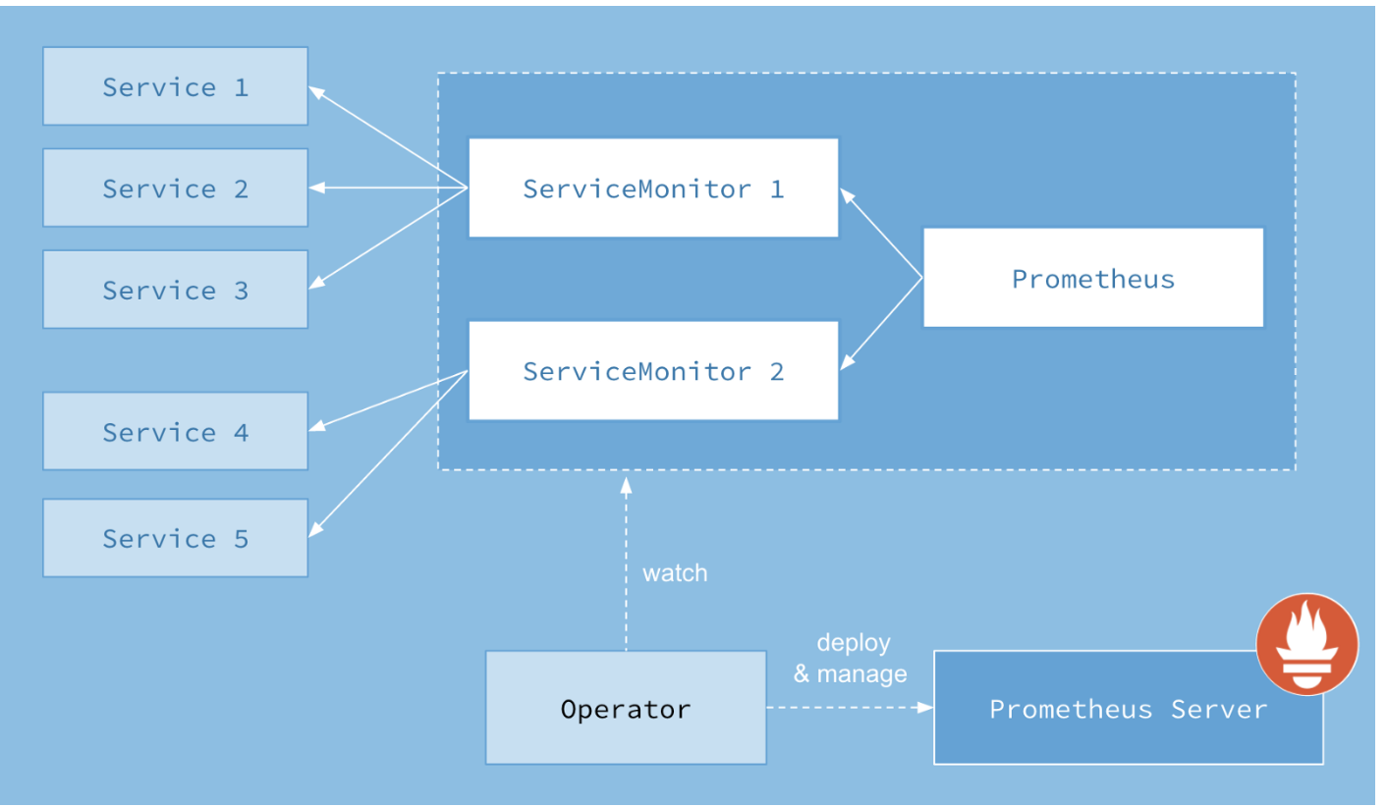
Prometheus

Slide 19
Lab: Dashboard Setup
https://github.com/shekhar2010us/kubernetes_teach_git/blob/master/kubernetes_dashboard_installation.md
Agile Brains Consulting
©Agile Brains Consulting Inc. All rights reserved. Not to be reproduced without prior written consent.
19

Slide 20
Lab: Kubernetes Monitor (cAdvisor+Prometheus)
https://github.com/shekhar2010us/kubernetes_teach_git/blob/master/k8s_monitor1/monitor.md

Slide 21
Lab: Kubernetes Monitor (cAdvisor+Prometheus+Grafana)
https://github.com/shekhar2010us/kubernetes_teach_git/blob/master/k8s_monitor2/monitor.md

Slide 22
Kubernetes Logging
Agile Brains Consulting
22
©Agile Brains Consulting Inc. All rights reserved. Not to be reproduced without prior written consent.

Slide 23
What to Log?
In order to monitor Kubernetes cluster activities we need to be able to log at the cluster level as well as at the node level.
For this, we need to augment the native logging functionality of a container. Example if a container dies, the pod gets evicted or if a node dies and the replication gets rescheduled, we still need to be able to access the application logs.
This necessitates separate storage and lifecycle independent of nodes, pods or containers.
Agile Brains Consulting
23
©Agile Brains Consulting Inc. All rights reserved. Not to be reproduced without prior written consent.

Slide 24
Lab: Basic Logging
https://github.com/shekhar2010us/kubernetes_teach_git/blob/master/k8s_logging/basic_logging.md
Agile Brains Consulting
24
©Agile Brains Consulting Inc. All rights reserved. Not to be reproduced without prior written consent.
Notes:
kubectl create -f https://k8s.io/examples/debug/counter-pod.yaml

Slide 25
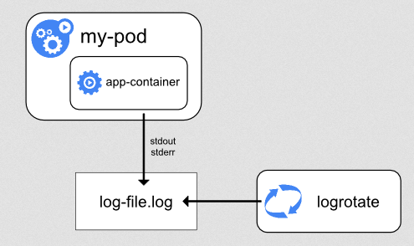
Cluster Level Logging in Kubernetes
Everything the container (application) writes to stdout and stderr are sent to an external log. We must implement log rotation to ensure that the space is not filled up!
Agile Brains Consulting
25
©Agile Brains Consulting Inc. All rights reserved. Not to be reproduced without prior written consent.

Slide 26
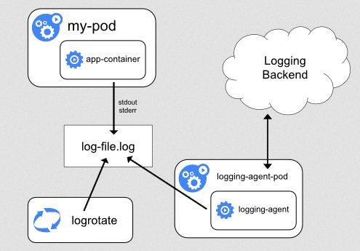
Cluster Level Logging in Kubernetes
By adding a node-level logging agent on each node we can push logs to a backend service to take the log lifecycle beyond that of a node.
Agile Brains Consulting
26
©Agile Brains Consulting Inc. All rights reserved. Not to be reproduced without prior written consent.

Slide 27
Before we setup a EFK cluster for logging, let’s get introduced with Helm
Agile Brains Consulting
27
©Agile Brains Consulting Inc. All rights reserved. Not to be reproduced without prior written consent.

Slide 28
Helm
What is Helm
Package manager in Kubernetes
Introduce concept of charts
Charts can be pre-defined or user-defined
Components:
Helm Client – To interact with helm
Tiller - receives the incoming request and installs the appropriate package. Also manage release and versions. Tiller contains the resource definitions to install a Kubernetes application
Agile Brains Consulting
28
©Agile Brains Consulting Inc. All rights reserved. Not to be reproduced without prior written consent.

Slide 29
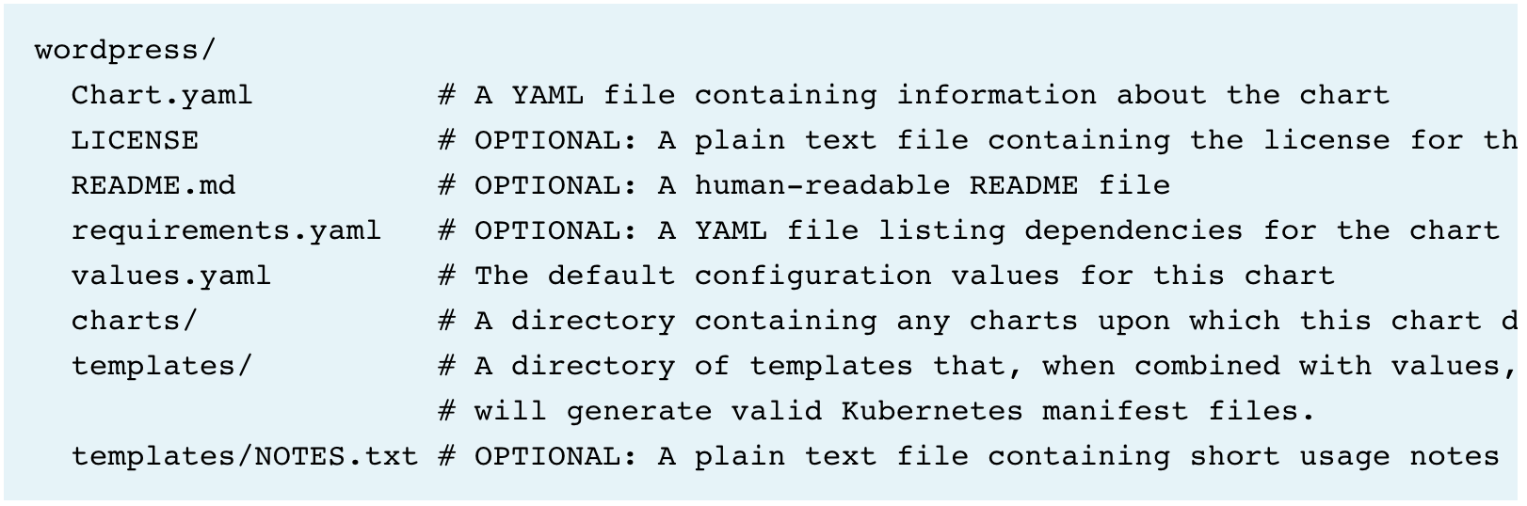
Helm Charts
What is Helm Charts
Packaging format – Collection of files (in a directory) having Kubernetes resources
Directory name = Chart name
Can be simple (deploy Redis) or complex (full stack web application)
An example directory
Agile Brains Consulting
29
©Agile Brains Consulting Inc. All rights reserved. Not to be reproduced without prior written consent.

Slide 30
Helm Charts
Chart.yaml
apiVersion: <chart api version>
name: <name of the chart>
version: <version>
kubeVersion: <kubernetes version>
description: <about project>
spec: {{.Values.imageRegistry}}
engine: <template engine name, default gotpl>
tillerVersion: <tiller version>
requirements.yaml – dependency on other charts
dependencies:
- name: apache
version: 1.2.3
repository: http://example.com/charts
- name: mysql
version: 3.2.1
repository: http://another.example.com/charts
values.yaml – provide values to templates
imageRegistry: “my-registry”
Agile Brains Consulting
30
©Agile Brains Consulting Inc. All rights reserved. Not to be reproduced without prior written consent.

Slide 31
Lab: Installing Helm
https://github.com/shekhar2010us/kubernetes_teach_git/blob/master/k8s_logging/helm.md
Agile Brains Consulting
31
©Agile Brains Consulting Inc. All rights reserved. Not to be reproduced without prior written consent.

Slide 32
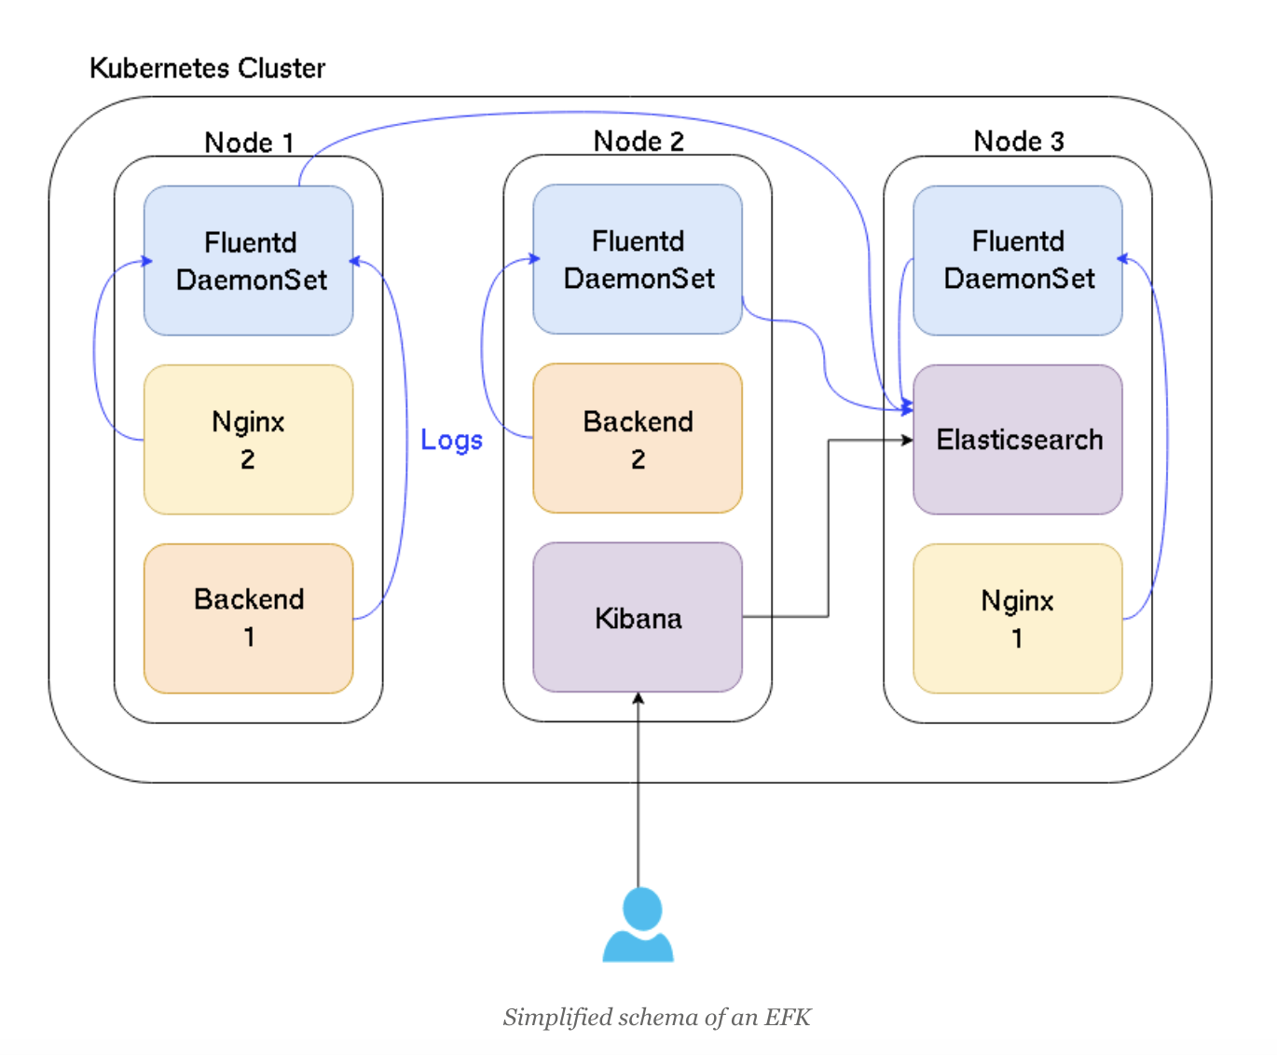
EFK Architecture

Slide 33
Lab: Logging using EFK
https://github.com/shekhar2010us/kubernetes_teach_git/blob/master/k8s_logging/efk_logging.md
Agile Brains Consulting
33
©Agile Brains Consulting Inc. All rights reserved. Not to be reproduced without prior written consent.

Slide 34
Kubernetes Health Check
- Liveness and Readiness
Agile Brains Consulting
34
©Agile Brains Consulting Inc. All rights reserved. Not to be reproduced without prior written consent.

Slide 35
Health Check Objectives – default options in k8s
Instance 1
Instance 2
Instance 1
Instance 2
yes
yes
no
yes
Requests
Requests
Other services should not access or send request to instance 1.
All containers in the pod should be healthy
Instance 1
Instance 2
yes
yes
Requests
Bring back the instance 1 to normal

Slide 36
Custom Health Check Options

Slide 37
Container Probes
Container probes
A Probe is a diagnostic performed periodically by the kubelet on a Container.
Two kinds of probes on running Containers:
Readiness probes:
To let know k8s when the app is ready to serve traffic. K8s will make sure that readiness probe passes before passing the traffic to it
If it fails, k8s will stop sending traffic until it passes again
Liveness probes:
To let know k8s if app is alive or dead
If the app is dead, k8s will remove the pod and start a new
Agile Brains Consulting
37
©Agile Brains Consulting Inc. All rights reserved. Not to be reproduced without prior written consent.

Slide 38
Liveness vs. Readiness Probes
When should you use liveness or readiness probes?
If you’d like your Container to be killed and restarted if a probe fails, then specify a liveness probe, and specify a restartPolicy of Always or OnFailure.
If you’d like to start sending traffic to a Pod only when a probe succeeds, specify a readiness probe
If you want your Container to be able to take itself down for maintenance, you can specify a readiness probe
Agile Brains Consulting
38
©Agile Brains Consulting Inc. All rights reserved. Not to be reproduced without prior written consent.

Slide 39
Container Probes Handlers
There are three types of handlers (being called by the kubelet running in the node):
ExecAction (Command): Executes a specified command inside the Container. The diagnostic is considered successful if the command exits with a status code of 0.
TCPSocketAction: Performs a TCP check against the Container’s IP address on a specified port. The diagnostic is considered successful if the port is open.
HTTPGetAction: Performs an HTTP Get request against the Container’s IP address on a specified port and path. The diagnostic is considered successful if the response has a status code greater than or equal to 200 and less than 400.
A probe has one of these 3 results:
Success: The Container passed the diagnostic.
Failure: The Container failed the diagnostic.
Unknown: The diagnostic failed, so no action should be taken.
Agile Brains Consulting
39
©Agile Brains Consulting Inc. All rights reserved. Not to be reproduced without prior written consent.
Notes:
https://cloud.google.com/blog/products/gcp/kubernetes-best-practices-setting-up-health-checks-with-readiness-and-liveness-probes

Slide 40
Container Probes Handlers
HTTP Type
apiVersion: v1
kind: Pod
metadata:
labels:
test: liveness
name: liveness-http
spec:
containers:
- name: liveness
image: k8s.gcr.io/liveness
args:
- /server
livenessProbe:
httpGet:
path: /healthz
port: 8080
httpHeaders:
- name: Custom-Header
value: Awesome
initialDelaySeconds: 3
periodSeconds: 3
perform a liveness probe every 3 seconds
send a HTTP GET request to the server
If HTTP returns between 200-400, all good
Otherwise, it will restart the pod
First 10 seconds, the command will succeed

Slide 41
Container Probes Handlers
Command Type
apiVersion: v1
kind: Pod
metadata:
labels:
test: liveness
name: liveness-exec
spec:
containers:
- name: liveness
image: k8s.gcr.io/busybox
args:
- /bin/sh
- -c
- touch /tmp/healthy; sleep 30; rm -rf /tmp/healthy; sleep 600
livenessProbe:
exec:
command:
- cat
- /tmp/healthy
initialDelaySeconds: 5
periodSeconds: 5
perform a liveness probe every 5 seconds
executes the command cat /tmp/healthy
If command succeeds, all good
Otherwise, restart the pod
First 30 seconds, the command will succeed

Slide 42
Container Probes Handlers
apiVersion: v1
kind: Pod
metadata:
name: goproxy
labels:
app: goproxy
spec:
containers:
- name: goproxy
image: k8s.gcr.io/goproxy:0.1
ports:
- containerPort: 8080
readinessProbe:
tcpSocket:
port: 8080
initialDelaySeconds: 5
periodSeconds: 10
livenessProbe:
tcpSocket:
port: 8080
initialDelaySeconds: 15
periodSeconds: 20
TCP Type
Similar to HTTP probe
Use both liveness and readiness
perform a liveness probe every 20 seconds
perform a readiness probe every 10 seconds
Try to connect to goproxy container at 8080

Slide 43
THANK YOU !!

